Slide 1
Exploring the prevalence of Eczema and MRSA in hospitalized patients in the State of Washington over the last 6 years.
Arjun Satheesan
Felcy Selwyn
Shipra Gupta
Venessa Lobo

Slide 2


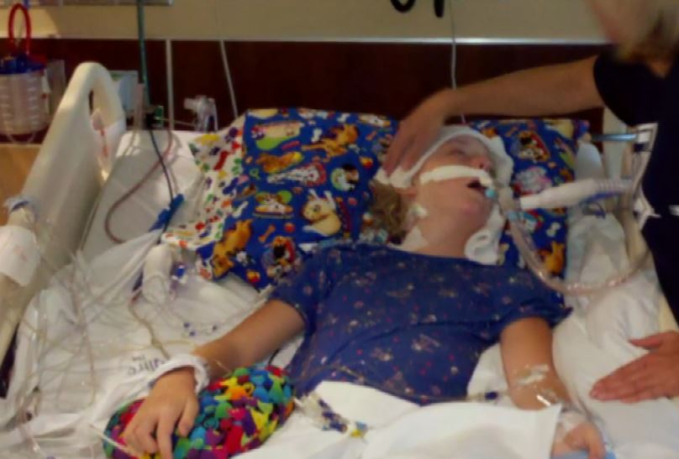
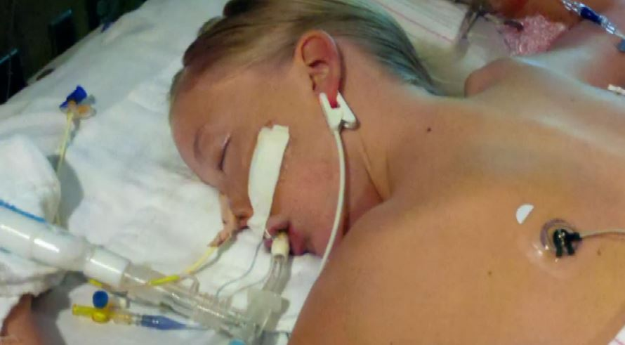
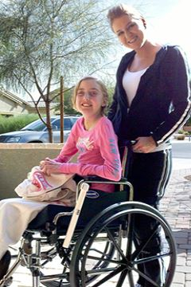
A real-life story…
May 2011
Pain in the hip
In a few days- Pneumonia
MRSA, Life support
Addy,11 yrs old
Addy on discharge
http://www.pbs.org/wgbh/frontline/film/hunting-the-nightmare-bacteria/
http://www.idsociety.org/Addie_Rerecich/
Notes:
Tuscon, AZ. I gave her some ibuprofen. As the night wore on, her pain got worse. where they said she had symptoms of a virus But over the next few days, the pain spread and the fever got worse. Went to another hospital that had specialized in children's care, They put her on antibiotics, diagnosed her with pneumonia, then she had little infected boils all over her body at which point they tested her for MRSA infection. The infection had so damaged her lungs, that she was put on life support. Lost both her lungs, legs, vision and one arm.
The culprit was MRSA, what is MRSA.

Slide 3
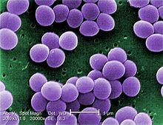
Staphylococcus aureus
Staphylococcus aureus (Staph) is a ubiquitous bacteria (1 in 3 people have Staph)
Causes a wide range of illness if it enters the body through a cut (acne ~ sepsis, death)
Gains resistance to antibiotics creating methicillin- resistant- staphylococcus aureus (MRSA)
Notes:
one in 3 people have Staph on the surface of the skin and nose, without causing infections

Slide 4

MRSA
Also called Superbug
Harder to treat - Resistant to most antibiotics
www.cdc.gov/MRSA

Slide 5
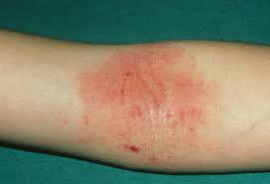
Eczema (Atopic Dermatitis)
Medical condition that causes skin dryness and inflammation
http://www.webmd.com/skin-problems-and-treatments/eczema/ss/slideshow-eczema-overview
Notes:
Now, shifting base, I will introduce Eczema, which

Slide 6
Hypothesis
Assumption: Eczema will predispose a person to MRSA as it causes a break in the skin integrity
Hypothesis: A person with eczema will have a higher chance of getting MRSA infection.
Notes:
Our overarching hypothesis hypothesis is that eczema will predispose a person to MRSA, therefore patients who have eczema will have a higher chance of getting MRSA.

Slide 7
Research Questions
How often does eczema diagnosis co-occur with MRSA, over the years 2009- 2014, among hospitalized patients in the state of Washington?
Is MRSA diagnosed more often in patients with skin infections or patients who have undergone surgical procedures among hospitalized patients in the state of Washington?
Are incidents of Eczema and MRSA co-occurrence more frequent in hospitalized children (0-3 yrs.) compared to hospitalized older patients (above 60 years), in the state of Washington?

Slide 8
Data – Initial Analysis
HCUP SID Data for the state of Washington for the years
2009-2014
Only hospitalized patient records
The ICD-9 diagnosis codes used in the study
041.12 – MRSA
692.9 - Dermatitis (Eczema)
686.9 - Unspecified local infection of skin and subcutaneous tissue

Slide 9
Some Features of Our Data
Total Number of Observations: 3,857,890 (Years 2009 to 2014)
For ‘Age’: Min – 0, Max – 120, Mean 46.75
Core Features | Frequency
Total number of cases with eczema (ICD9 Code - 6929) over 2009-2014 | 14,280
Total number of cases with MRSA (ICD9 Code - 04112) over 2009-2014 | 29,680
Total number of cases with MRSA and eczema co-occurring over 2009-2014 | 340
Total number of cases with local skin infection (ICD9 Code - 6869) over 2009-2014 | 2007
Total Number of cases with surgery (ORPROC -1) over 2009-2014 | 1,144,949
Number of patients in the age group 0-3 yrs over 2009-2014 | 567,415
Number of patients aged 60 and above over between 2009-2014 | 1,529,539

Slide 10
Sampling
Case – Control -> 1 : 2
Confounding Factors
Age
Admission Month
Gender
Admission Type :
Emergency
Urgent
Elective
Target: People with MRSA and Eczema
Source: HCUP Data - WA
Eligible:
Patients with MRSA and control without MRSA
Study: 29653 cases eligible of MRSA
61827 control cases without MRSA

Slide 11
Research Questions
How often does eczema diagnosis co-occur with MRSA, over the years 2009- 2014, among hospitalized patients in the state of Washington?

Slide 12
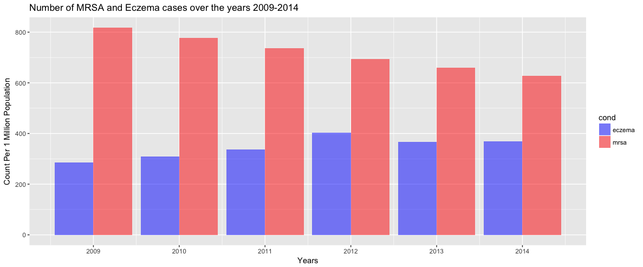
MRSA and Eczema Distribution
Total number of patients with MRSA and eczema co-occurrence over 2009-2014 = 340

Slide 13
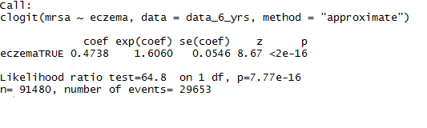
Does having eczema increase a person’s chance of getting MRSA infection?
Statistically significant?
Conditional Logistic Regression
The odds of the patient having MRSA increases by 60% if they have Eczema

Slide 14
Research Questions
How often does eczema diagnosis co-occur with MRSA, over the years 2009- 2014, among hospitalized patients in the state of Washington?
Is MRSA diagnosis more common in patients with skin infections or patients who have undergone surgical procedures among hospitalized patients in the state of Washington?

Slide 15
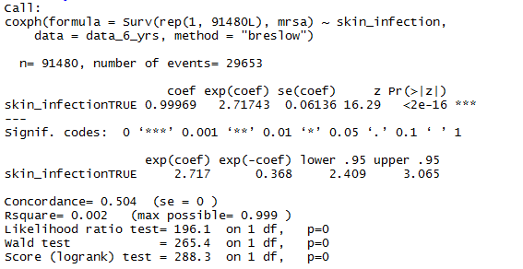
Does having skin infection increase the chances of getting MRSA infection?
Conditional Logistic Regression
The odds ratio of the patient having MRSA is 2.71743
Possibly due undiagnosed MRSA infection within the ICD 9 Skin Infection code

Slide 16
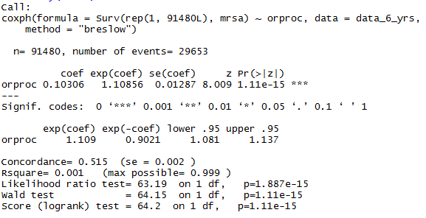
Does having surgery increase the chances of getting MRSA infection?
Conditional Logistic Regression
The odds of the patient having MRSA increases by 10% if they have a Surgery

Slide 17
Research Questions
How often does eczema diagnosis co-occur with MRSA, over the years 2009- 2014, among hospitalized patients in the state of Washington?
Is MRSA diagnosed more often in patients with skin infections or patients who have undergone surgical procedures among hospitalized patients in the state of Washington?
Are incidents of Eczema and MRSA co-occurrence more frequent in hospitalized children (0-3 yrs.) compared to hospitalized older patients (above 60 years), in the state of Washington?

Slide 18
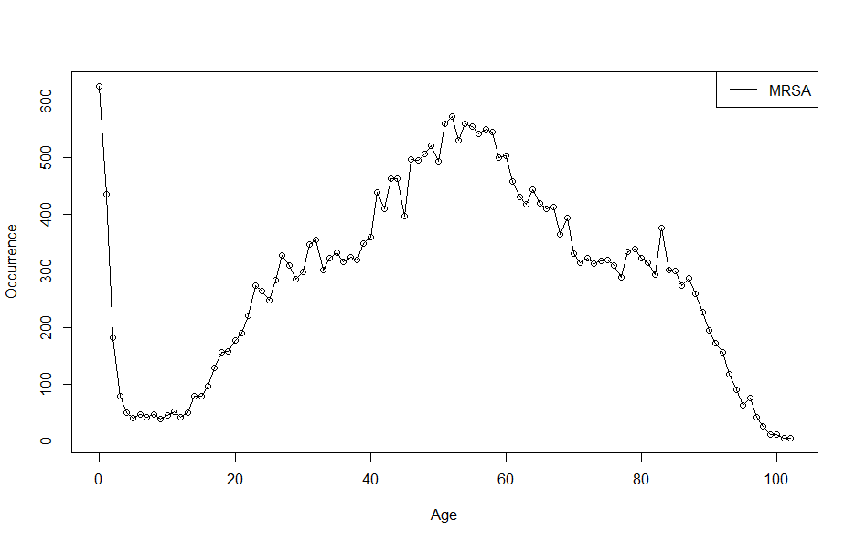
MRSA Occurrence over the ages?

Slide 19
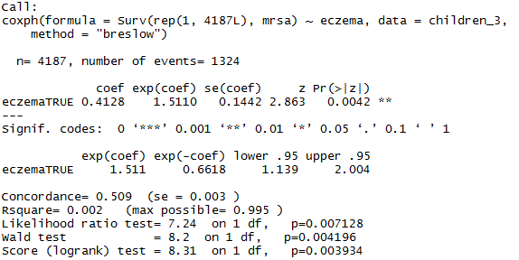
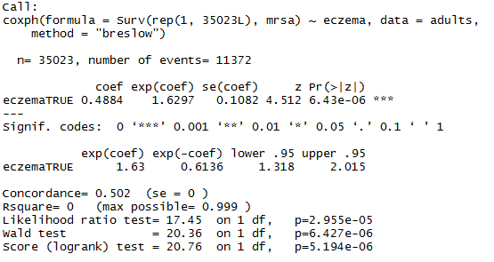
Conditional Logistic Regression
Children <= 3
Older patients >= 60

Slide 20
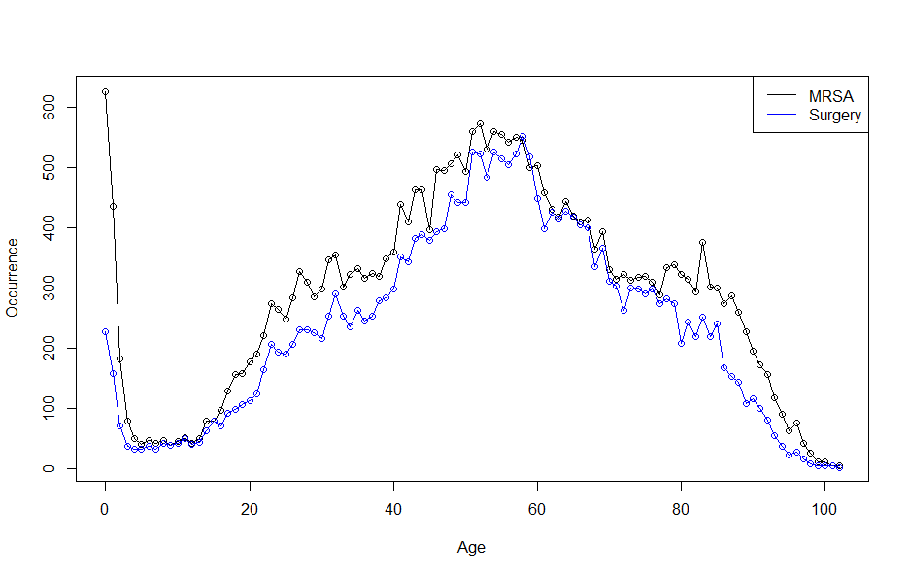
Can the peaks be explained due to surgery?

Slide 21
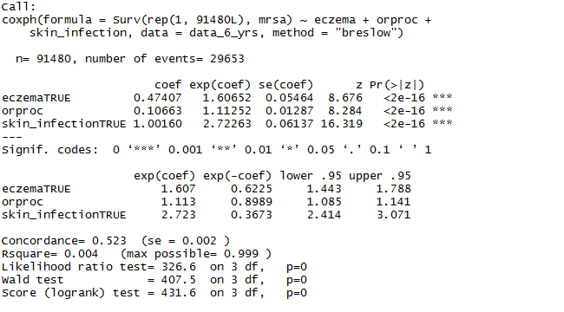
Clogit with multiple predictors
Clogit with 1 predictor | exp(coef)
Eczema | 1.6060
Surgery | 1.10856
Skin Infection | 2.71743

Slide 22
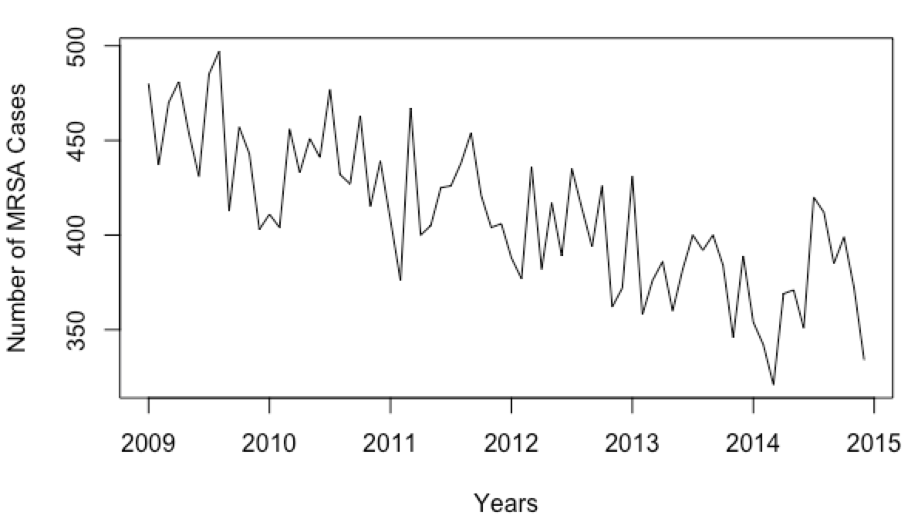

Time Series Analysis

Slide 23
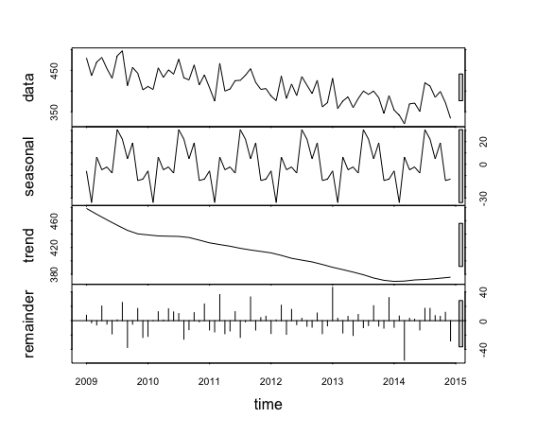
Time Series Analysis
fit <- stl(time_series, s.window="period")
plot(fit)

Slide 24
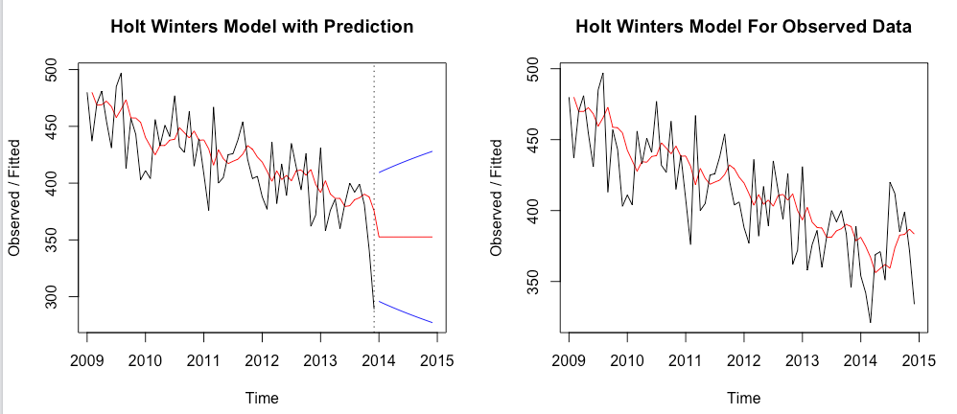
Time Series Analysis
plot(hw_training, forecast_training, main = "Holt Winters Model with Prediction")
plot(hw, main = "Holt Winters Model For Observed Data")
par(mfrow = c(1,2))

Slide 25
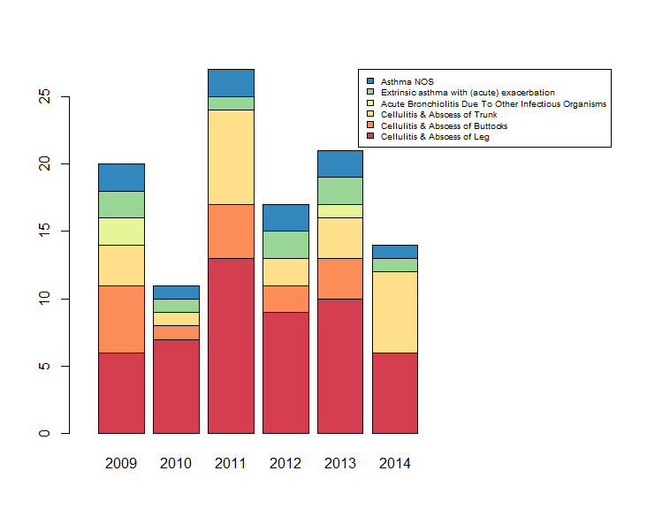
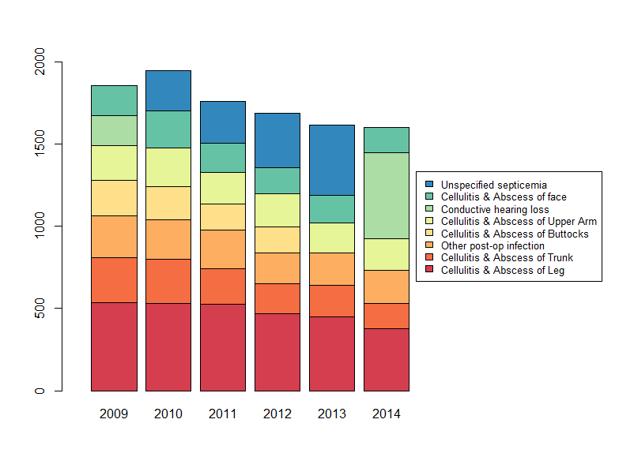
What is the top primary diagnosis commonly associated with MRSA and Eczema?
MRSA
Eczema

Slide 26
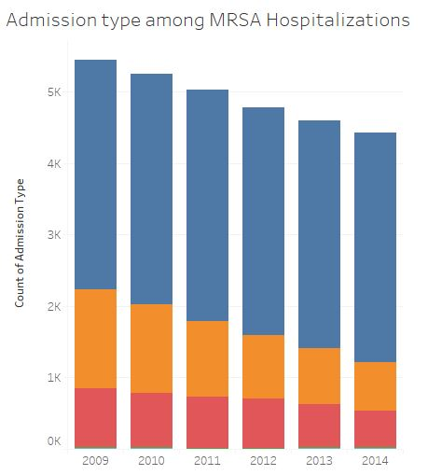
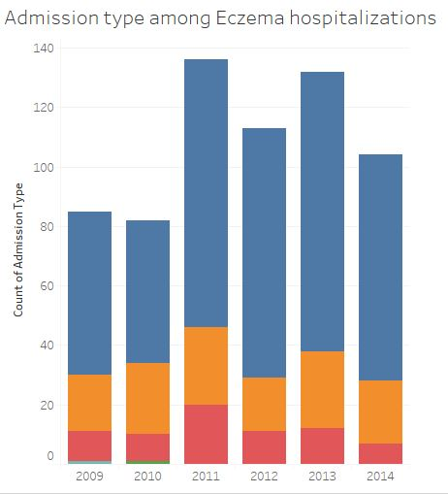
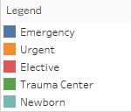
What is the most common admission type associated with MRSA and Eczema Hospitalizations ?

Slide 27
Discussion
Eczema increased the chance of acquiring MRSA by 60% for a hospitalized patient.
Additional factors about MRSA hospitalizations that we discovered were:
Surgery
Cellulitis and Abscess of the leg
Admissions in the emergency room
Seasonality
Limitations: representative of only hospitalized patients
Insights: Topical steroid treatment of eczema play a role?

Slide 28
Thank You!
Enjoy your Spring Break!
☺

